Slide 1

Digital Portfolio
STUDENT NAME: ABISHEK V
REGISTER NO AND NMID: asunm1703222410117
DEPARTMENT: B.SC Computer Science
COLLEGE: Aksheyaa college of arts and science / University of Madras.
1
Notes:
1

Slide 2

PROJECT TITLE
Simple and Formal Resume
Digital portfolio using Frent end development
2
Notes:
Let's take a closer look at my project title. This is an opportunity to set the stage for what my project is all about.
[Pause briefly to let the audience absorb the title.]
As we explore this project, remember that a good title gives a glimpse into the essence of the work—it's the first impression that sets expectations. [Emphasize the importance of the title briefly.]
Consider how this title aligns with the goals and objectives of the project. It's designed to be both descriptive and engaging, offering a snapshot of the journey we will undertake together.
[Pause to let these thoughts sink in before moving to the next slide.]

Slide 3



AGENDA
Problem Statement
Project Overview
End Users
Tools and Technologies
Portfolio design and Layout
Features and Functionality
Results and Screenshots
Conclusion
Github Link
3/21/2024 Annual Review
3

Slide 4

PROBLEM STATEMENT
A normal paper resume is plain and limited in design, which makes it hard to show creativity and stand out. To solve this, I created a digital resume that presents my personal details, skills, education, and projects in a clear, attractive, and easily accessible way.
4

Slide 5

PROJECT OVERVIEW
The project focuses on developing a DigitalPortfolio Website to showcase personal details, academic background, technical skills, and project work. The portfolio emphasizes user-friendly design, responsive layout, and interactive elements, enabling viewers to navigate easily and understand the profile.
5

Slide 6

WHO ARE THE END USERS?
1.Students & Professionals - To showcase their skills and achievements.
2.Recruiters & Employers - To evaluate candidates' capabilities beyond a traditional resume.
3.Academic Institutions - For student project submissions and evaluations.
6

Slide 7

TOOLS AND TECHNIQUES
Front-end: HTML, CSS, JavaScript.
Version Control: GitHub
Design Tools: Canva(for layout design)
7

Slide 8
PORTFOLIO DESIGN AND LAYOUT
Home page: Introduction and Banner Section.
About Section: Personal Details, Academic Profile.
Skills Section: Technical expertise and Skills.
Contect Section: Address, email and phone number.
8

Slide 9
PORTFOLIO DESIGN AND LAYOUT
Proper use of fonts, spacing, and alignment makes the design professional.
The layout is simple, attractive, and user-friendly, making the information easy to follow.

Slide 10
FEATURES AND FUNCTIONALITY
Provides a clear and organized structure for personal, academic, and professional details.
Interactive navigation with responsive design.
Accessible anytime and anywhere in digital format.
Compatible across devices such as laptops, tablets, and smartphones.
Contact form for direct communication.

Slide 11

RESULTS AND SCREENSHOTS
Successfully deployed Digital Portfolio Website
Enhanced visibility of projects and skills
Positive feedback from peers and mentors
3/21/2024 Annual Review
10

Slide 12
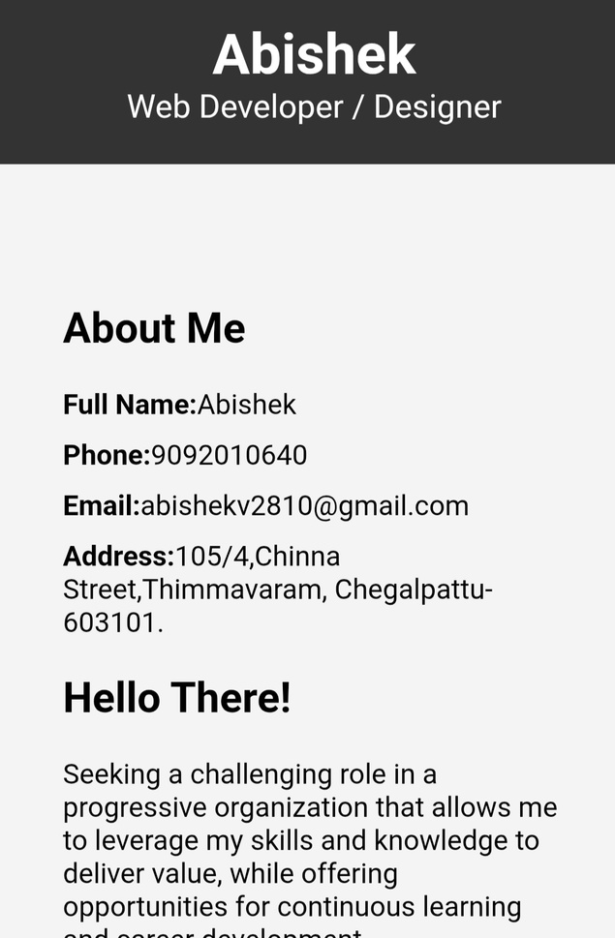
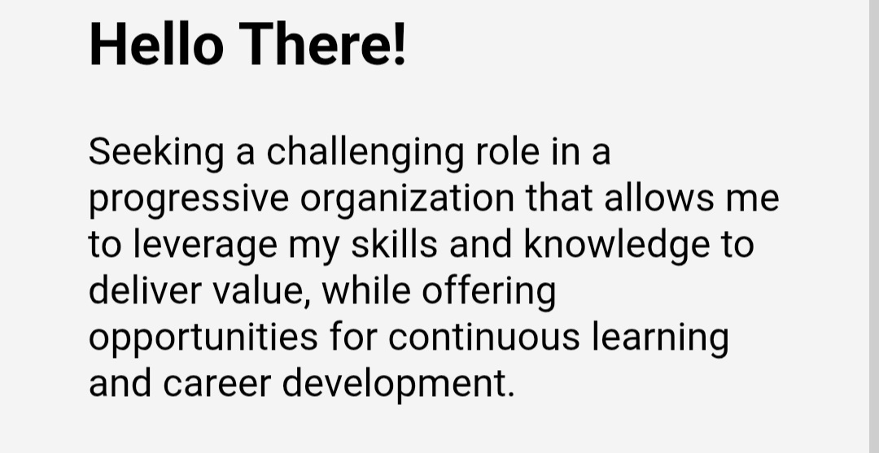
RESULTS AND SCREENSHOTS
11

Slide 13
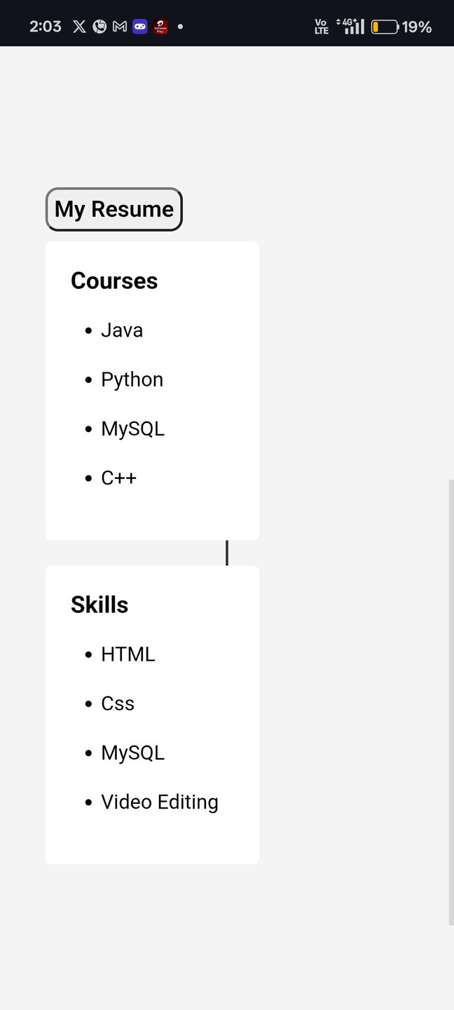
RESULTS AND SCREENSHOTS
11

Slide 14
CONCLUSION
This project provides a simple and creative way to present details in a digital format. It is easy to update, accessible, and more attractive than a traditional resume.
11

Slide 15
GitHub Link
https://github.com/Abishekv200/digital_portfolio.git
11

